Slide 1
Body Fat Assignment
Stat 628 Module 2
RUI HUANG
CHENYANG JIANG
HanGyu KANG
ENZE WANG

Slide 2
Body Fat Assignment
Introduction
Data Analysis and Data Clean
Variables Selection
Model Selection
Model Diagnosis and Summary
Shiny Application
Acknowledge

Slide 3
Introduction
Body Fat Percentage is the total mass of fat divided by total body mass.
Essential body fat is necessary for healthy daily life, but large body fat is harmful to human health.
A precise way to measure body fat is to combine submersion method with Siri equation (Body fat=495/Density-450). But it is difficult.
Our groups want to use several human measurements including age, weight to predict body fat.

Slide 4
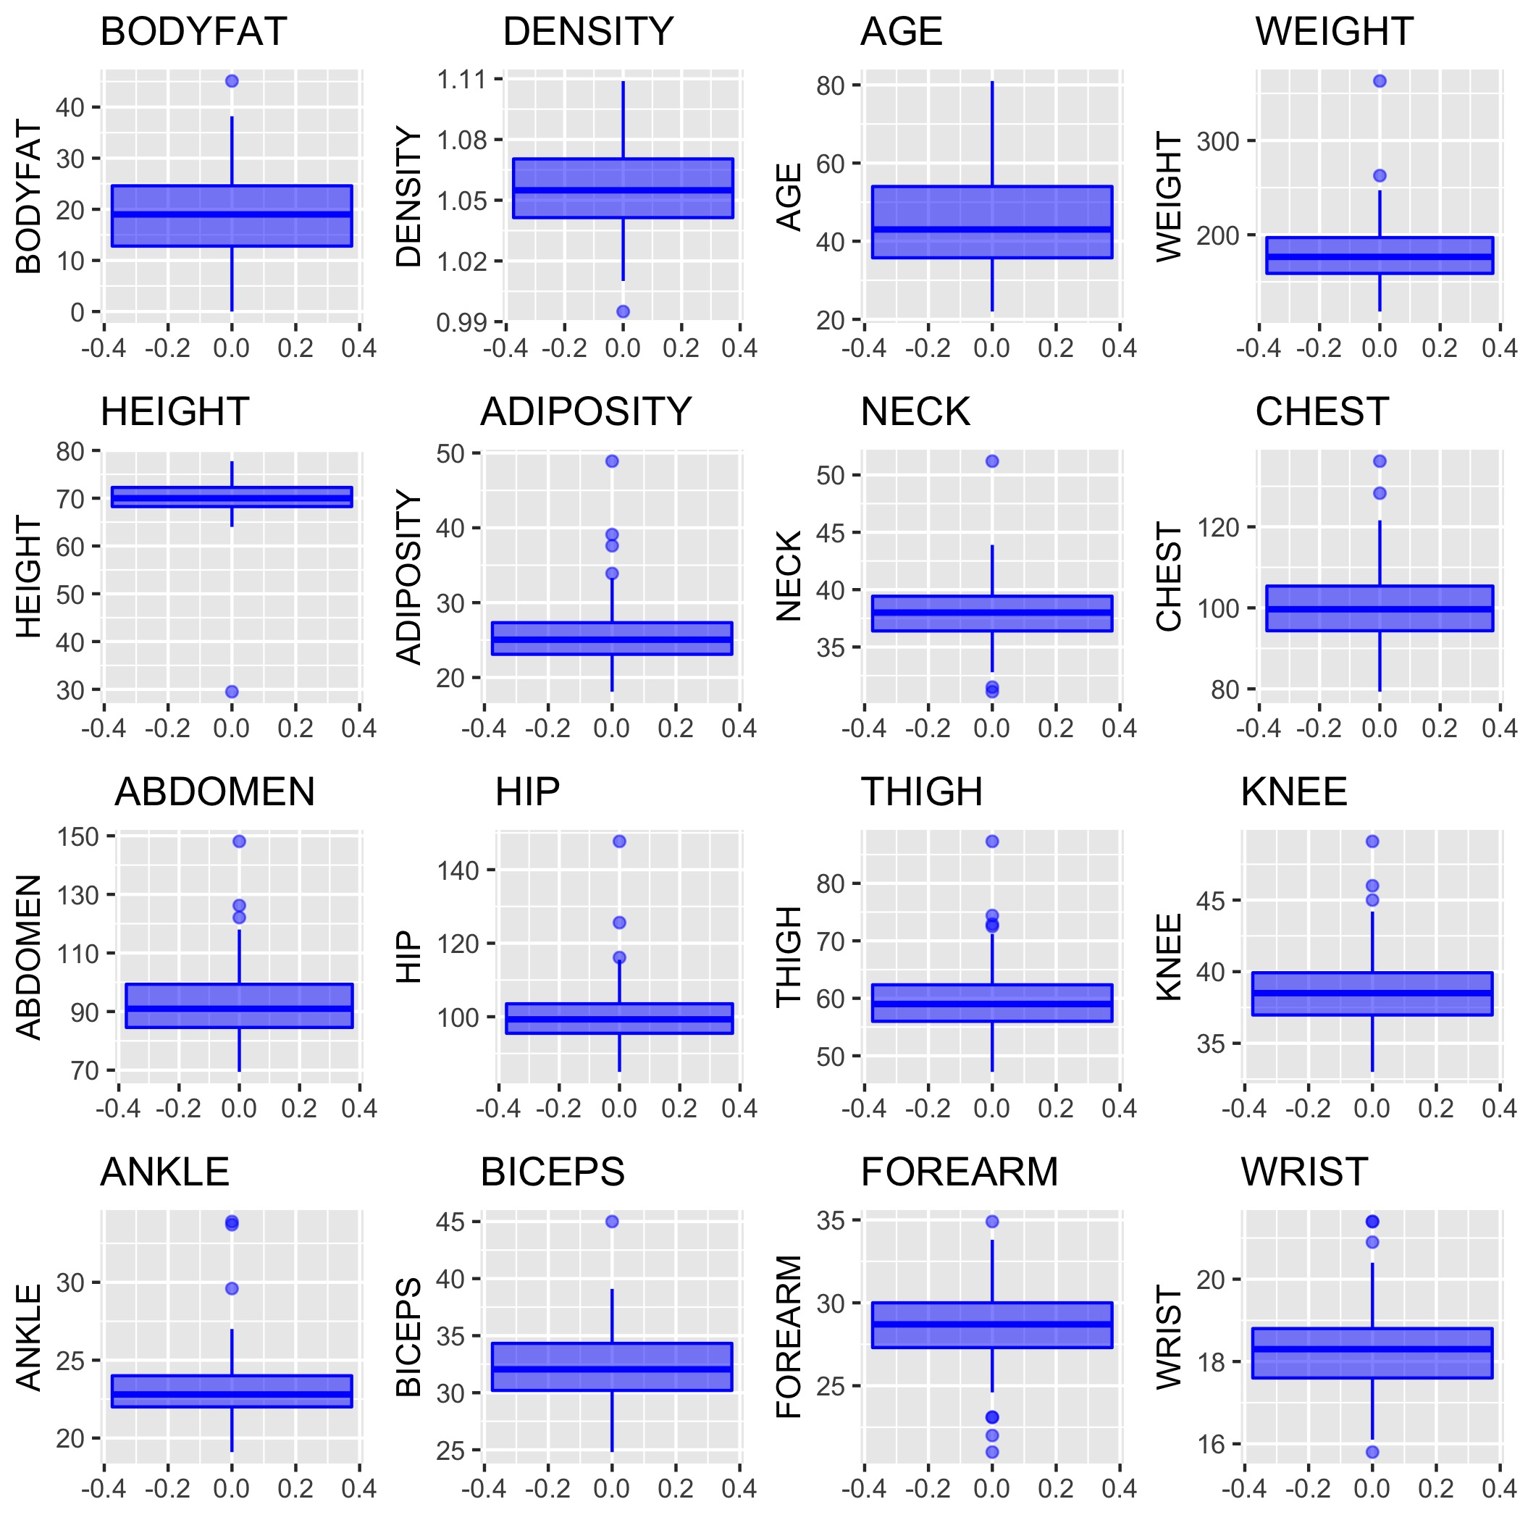
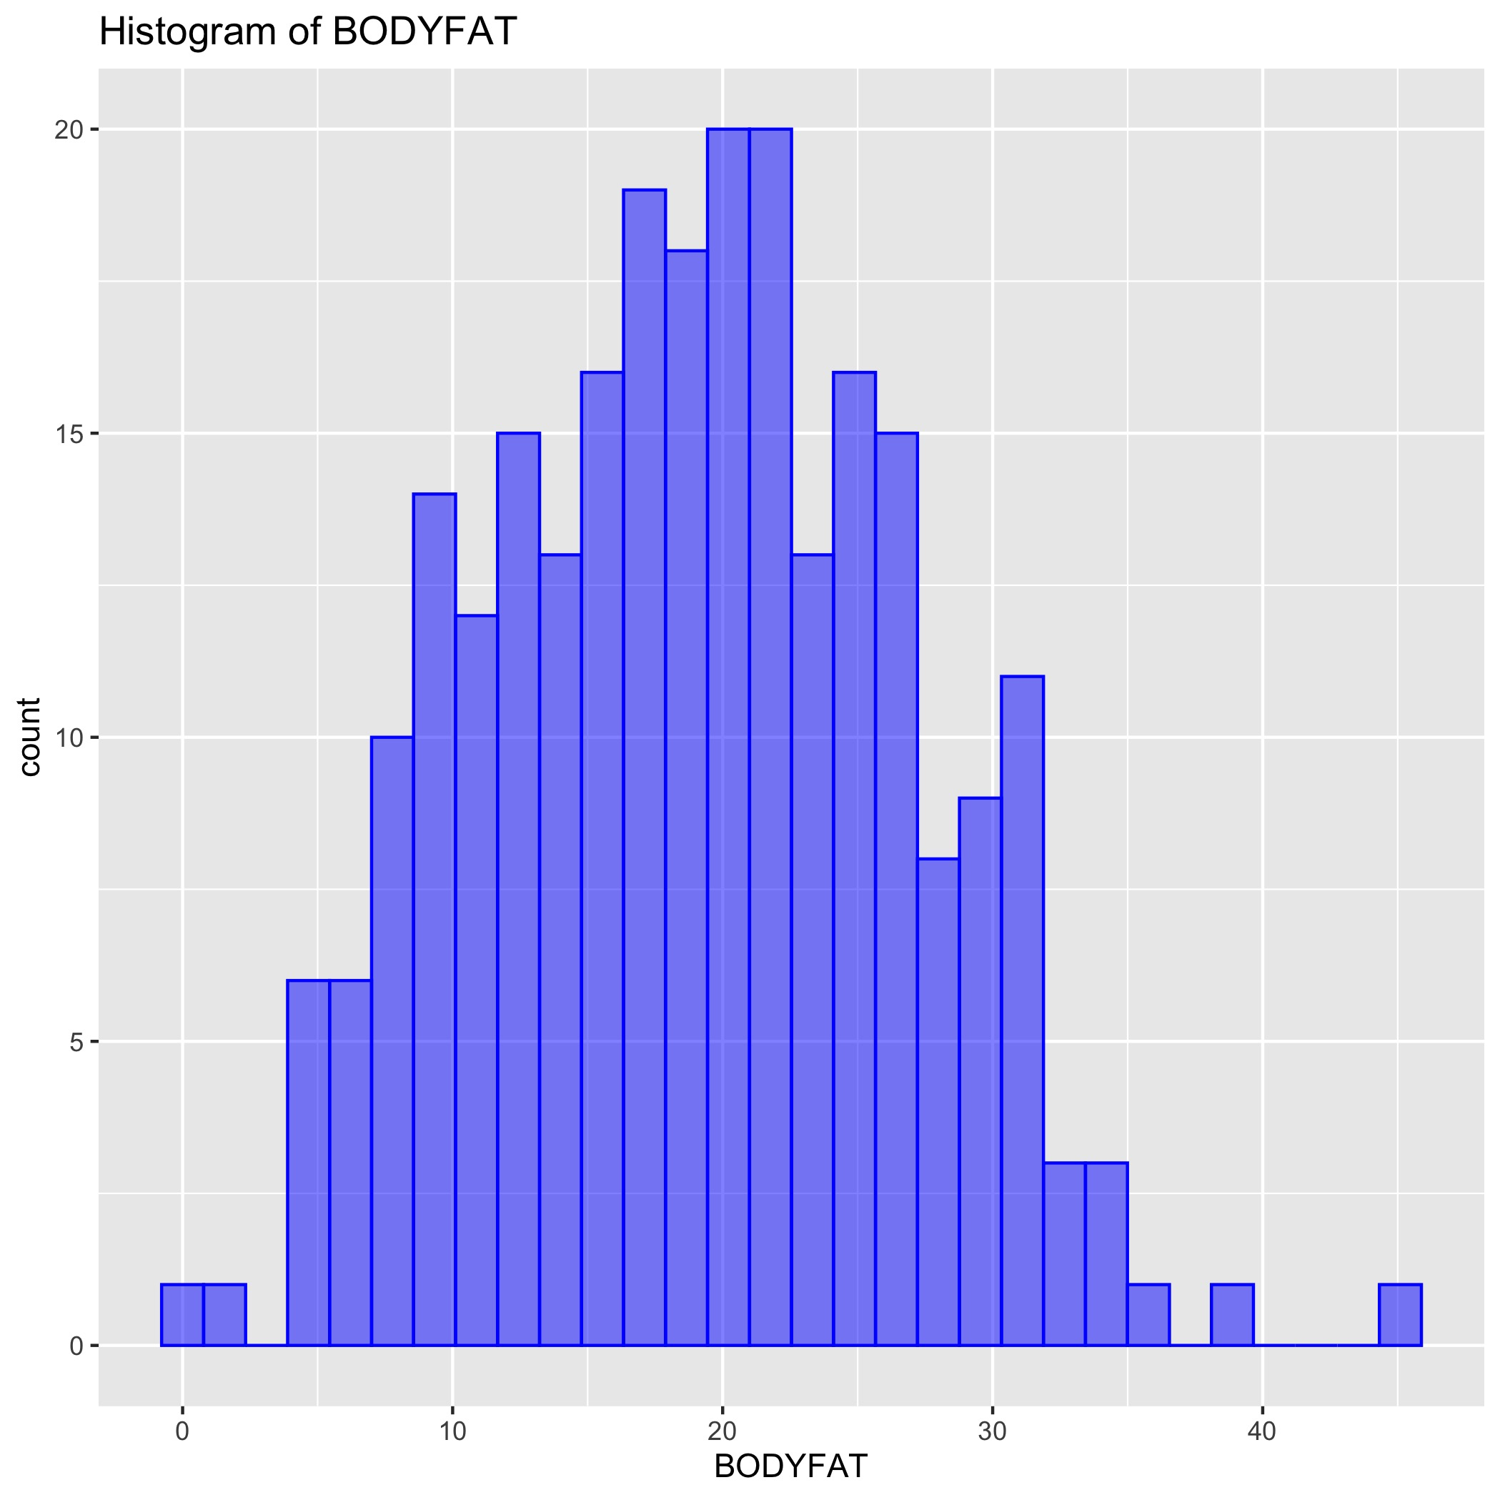
Data Analysis
Data Visualization
Any outliers
Data distribution
Null and abnormal value

Slide 5
Data Clean - Boxplots
Method to outliers from boxplots
Suspicious outliers:
IDNO | Reason | Method
182 | BODYFAT is 0 | Remove
216 | Extreme value in BODYFAT | Remove
39 | Outliers from boxplots | Remove
42 | Low HEIGHT | Fix by BMI equation
41 | Outliers from boxplots | Remove

Slide 6
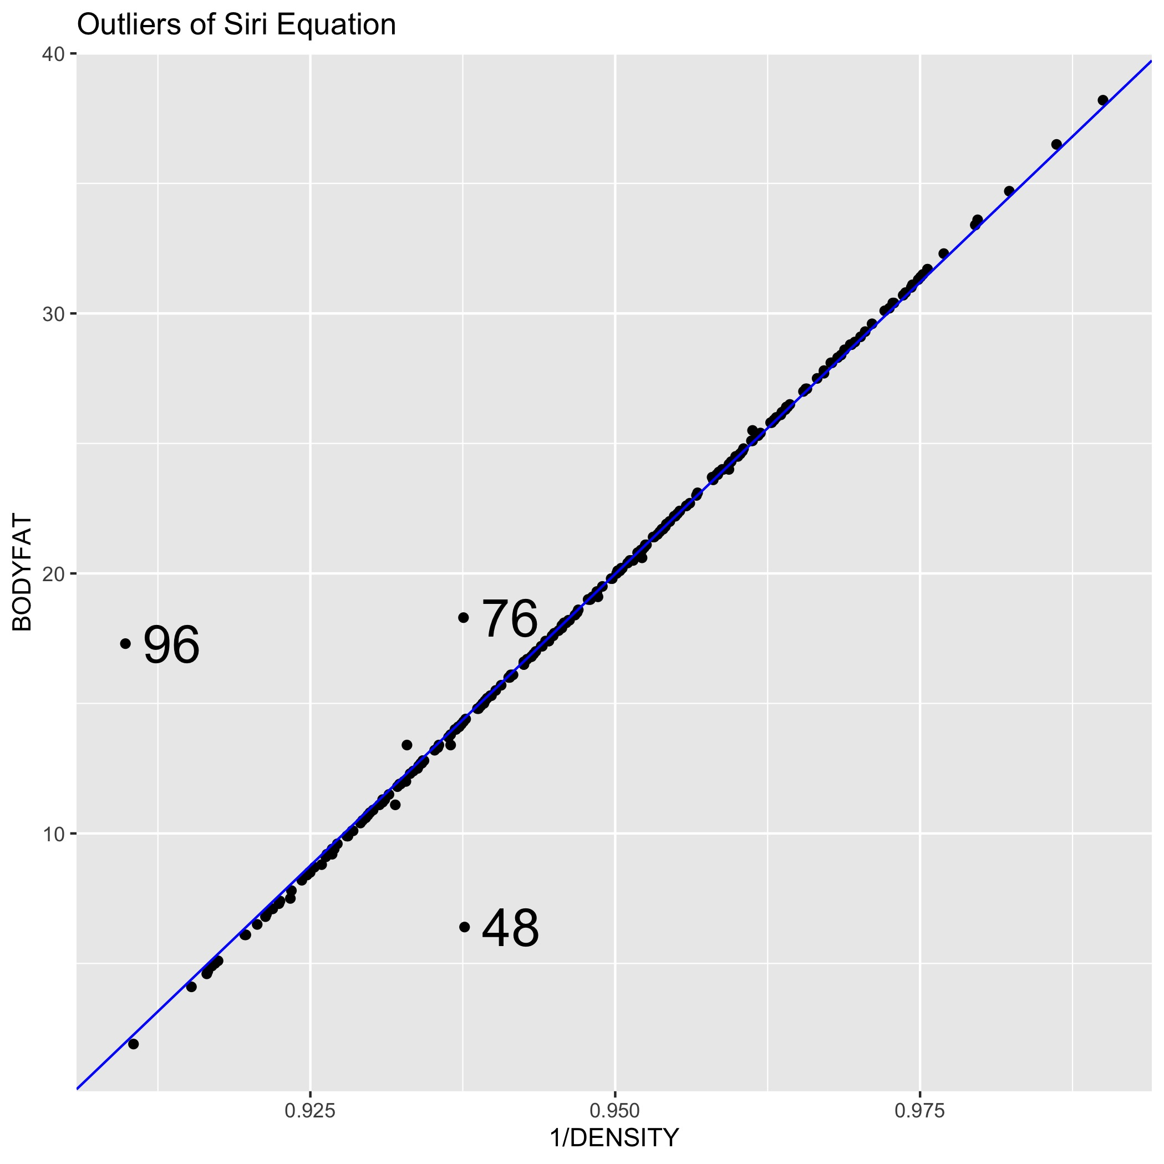
Data Clean – Siri Equation
Connection between BODYFAT and DENSITY in our data is called Siri equation:
Siri equation: BODYFAT=495/DENSITY-450
Outliers in regression between BODYFAT and 1/DENSITY
IDNO | Initial BODYFAT | New BODYFAT | Method
96 | 17.3 | 0.36 | Update DENSITY: 1.06
76 | 18.3 | 14.09 | Update BODYFAT: 14.09
48 | 6.4 | 14.13 | Update BODYFAT: 14.13

Slide 7
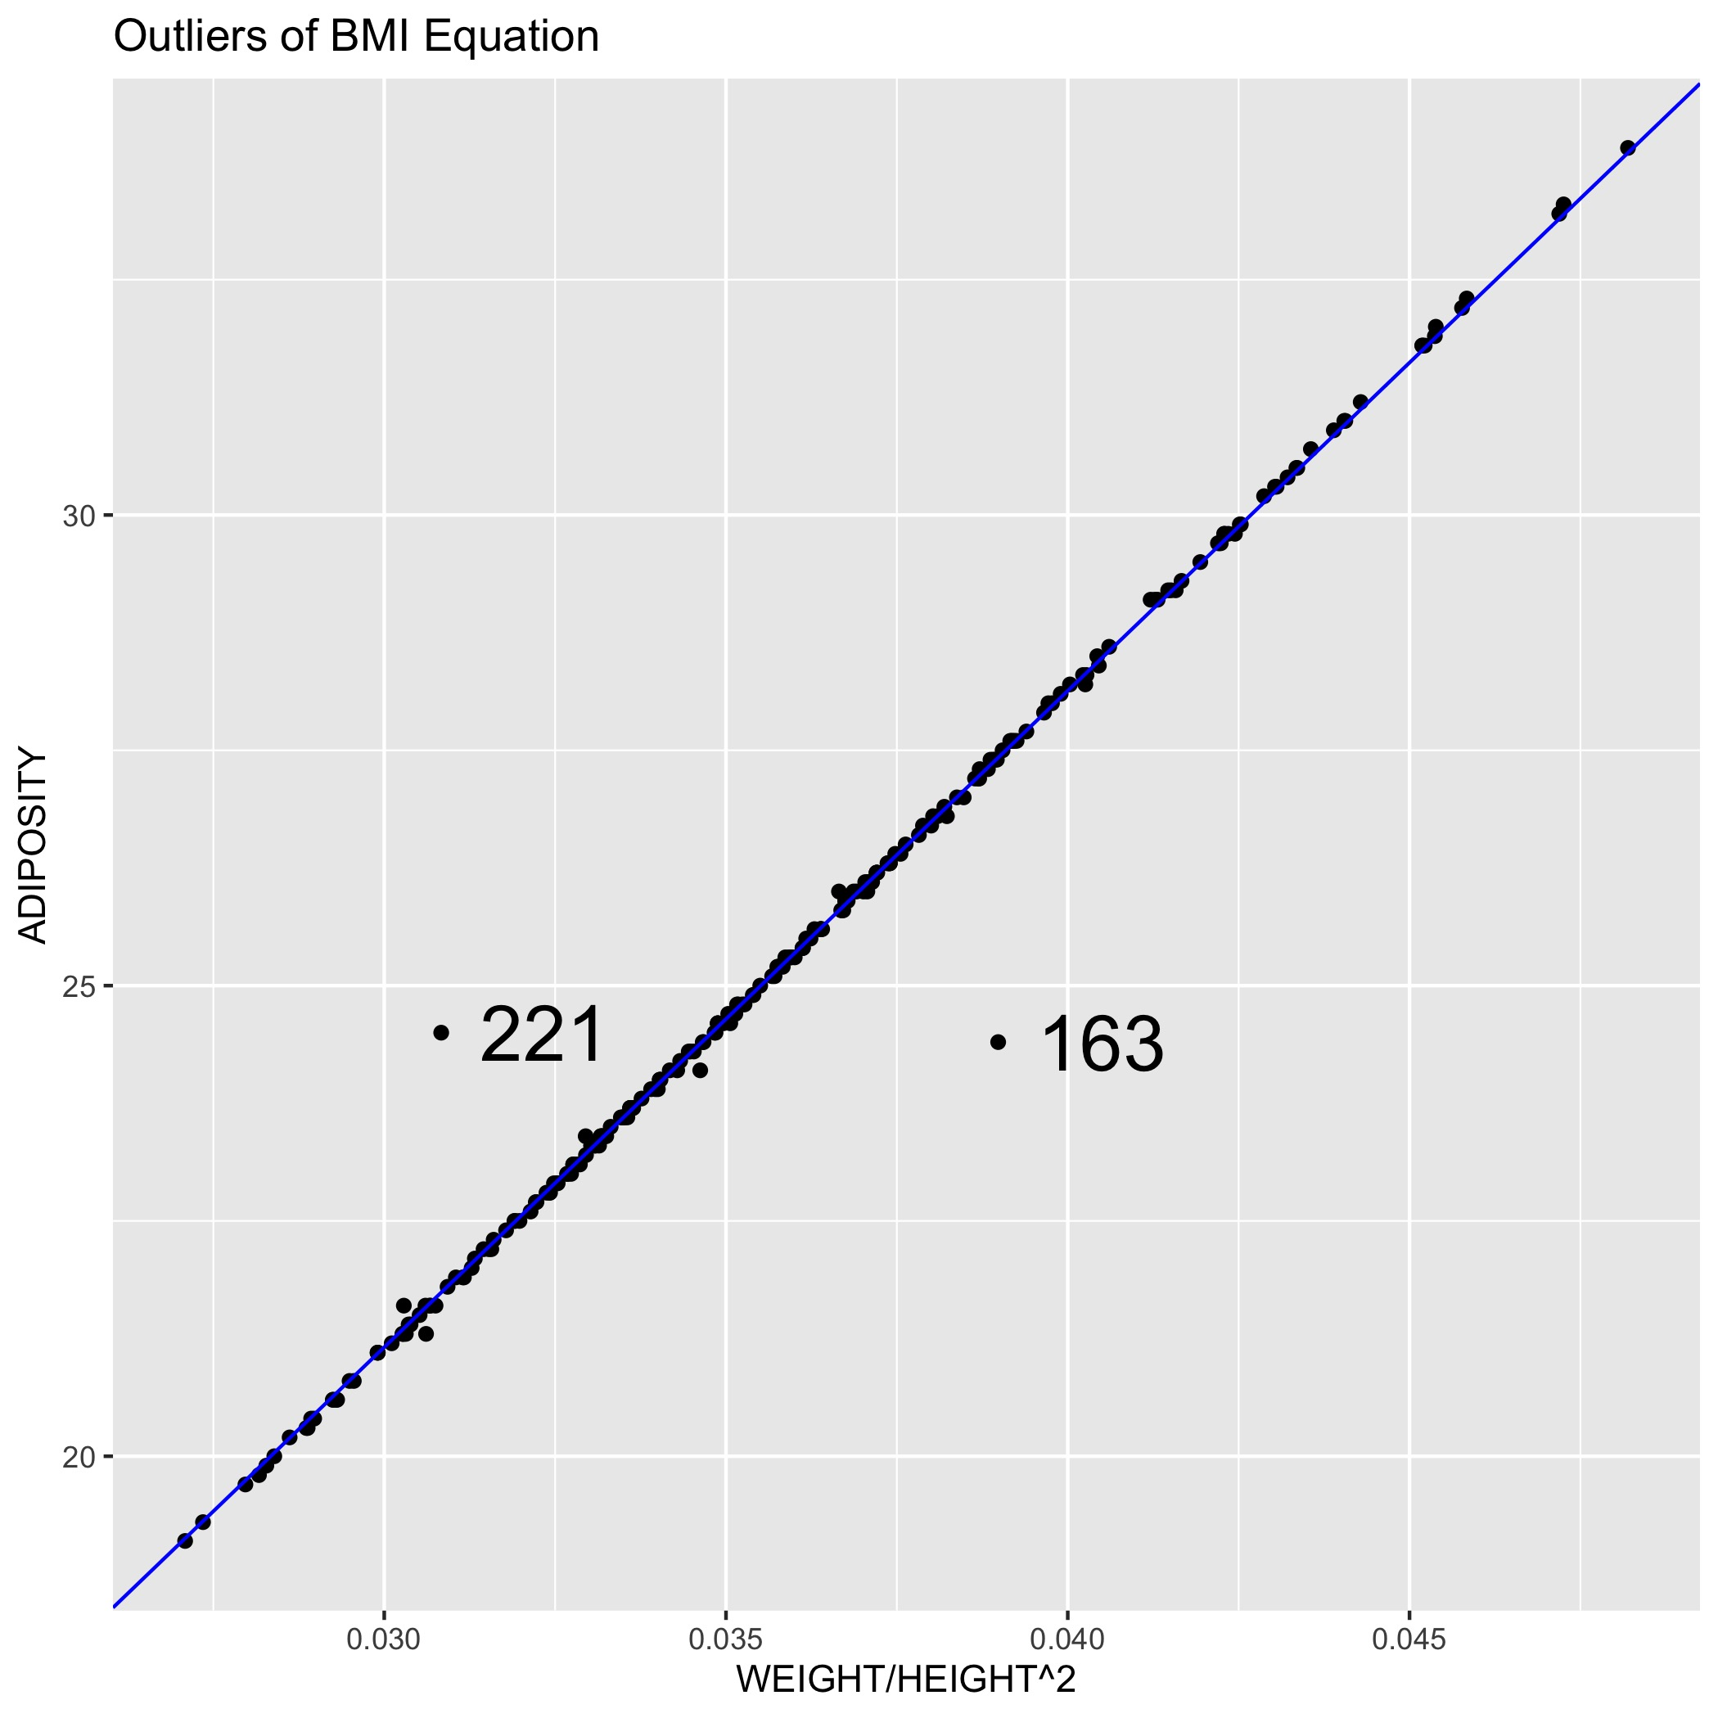
Data Clean – BMI Equation
Connection among ADIPOSITY, WEIGHT and HEIGHT in our data is called BMI equation:
BMI equation: ADIPOSITY=703 WEIGHT/HEIGHT²
Outliers in regression between ADIPOSITY and WEIGHT/HEIGHT²
IDNO | Initial ADIPOSITY | New ADIPOSITY | Method
163 | 24.4 | 27.4 | Update ADIPOSITY: 1.06
221 | 24.5 | 21.7 | Update ADIPOSITY: 14.09

Slide 8
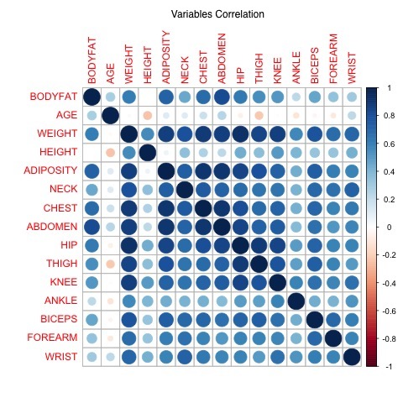
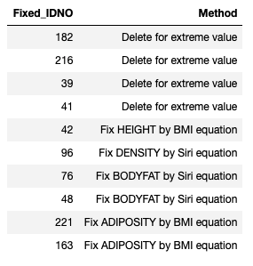
Clean Data - Summary
It is a trade off to keep or remove outliers.
There is high correlation among variables after clean.

Slide 9
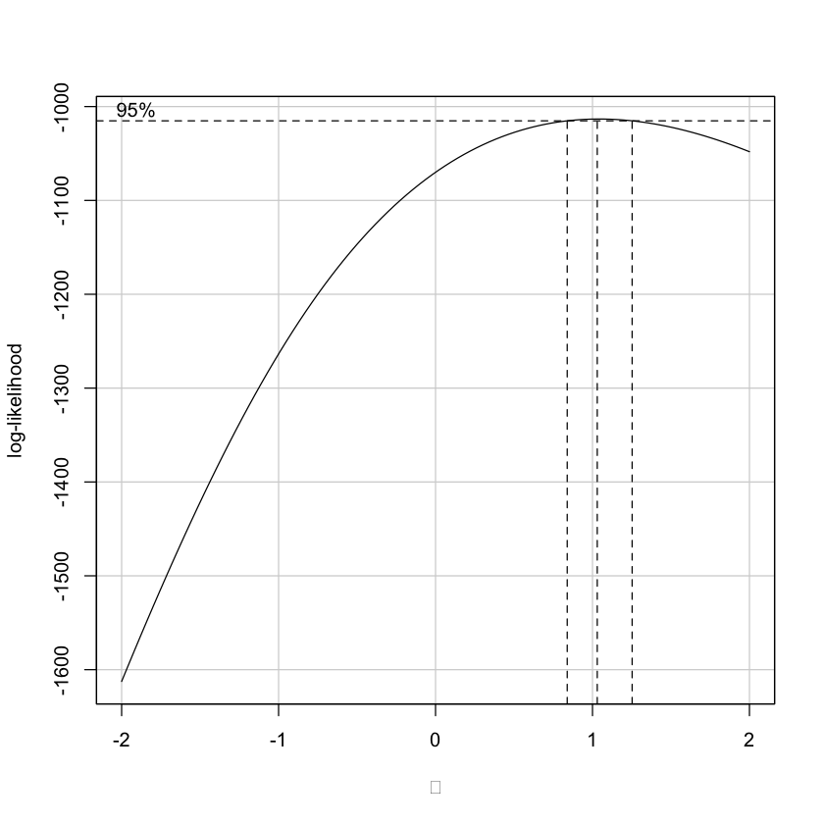
Variables Selection – Model Build
It is unnecessary to transformation on y according to BOXCOX.
It is useless to use PCA for model build
From simple linear regression of all variables, many variables is not significant and there is serious multicollinearity, the mean of VIF is 42.
Therefore, it is necessary to select variables.

Slide 10
Variables Selection – Basic Idea
Method:
Lasso Regression
Subsets Method with Cp and BIC
Forward Directions Search with AIC and BIC
We prefer both simple and precise model.
Full Model:
Full Model with all variables: BODYFAT~AGE+WEIGHT+HEIGHT+ADIPOSITY+NECK+CHEST+ABDOMEN+HIP+THIGH+KNEE+ANKLE+BICEPS+FOREARM+WRIST
Full Model with all variables after log (log()) transformation
Full Model with all variables after square(^2) transformation
Full Model with all variables from 1, 2, 3.
We still want to figure out any improvement after transformation on x

Slide 11
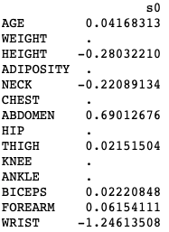
Variables Selection – Lasso Regression
Results: BODYFAT ~ AGE + HEIGHT + NECK + ABDOMEN + BICEPS + FOREARM + WRIST + THIGH
The multicollinearity is not so serious, the mean of VIF is 2.88.

Slide 12
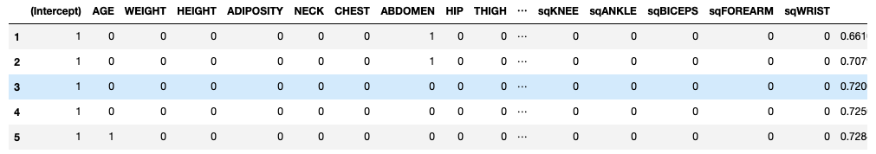
Variables Selection – Subsets Method
Here we only give results from all variables including square and log transformation.
BODYFAT~ABDOMEN R squared = 0.66
BODYFAT~ABDOMEN + sqWEIGHT R squared = 0.71
BODYFAT~LogWRIST + sqHEIGHT + LogABDOMEN R squared = 0.72
From four full model, the ABDOMEN is the most important variable. WEIGHT, WRIST are also very important.

Slide 13
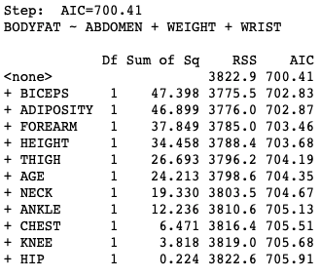
Variables Selection – Forward Directions Search
Here we only give results from BIC:
BODYFAT ~ ABDOMEN + WEIGHT + WRIST BIC=700.41
BODYFAT ~ LogABDOMEN + LogWRIST + LogHEIGHT BIC=697.82
BODYFAT ~ sqABDOMEN + sqWEIGHT + sqWRIST BIC=705.87
BODYFAT ~ ABDOMEN + sqWEIGHT + LogWRIST BIC=697.68
BIC will give simpler models than AIC.
ABDOMEN is also the most important variable.

Slide 14
Variables Selection – Summary
11 alternative models:
BODYFAT ~ ABDOMEN + sqWEIGHT + LogWRIST
BODYFAT ~ ABDOMEN + sqWEIGHT
BODYFAT ~ sqABDOMEN + sqWEIGHT + sqWRIST
BODYFAT ~ sqABDOMEN + sqWEIGHT
BODYFAT ~ sqABDOMEN
BODYFAT ~ LogABDOMEN + LogWRIST + LogHEIGHT
BODYFAT ~ LogABDOMEN + LogWRIST
BODYFAT ~ LogABDOMEN
BODYFAT ~ ABDOMEN + WEIGHT + WRIST
BODYFAT ~ ABDOMEN + WEIGHT
BODYFAT ~ ABDOMEN

Slide 15
Model Selection – 30 - Repeated with 10 - fold Cross Validation
ID | Model | Root Mean Squared Error | R-squared
1 | BODYFAT ~ ABDOMEN + sqWEIGHT + LogWRIST | 3.937862 | 0.7247008
2 | BODYFAT ~ ABDOMEN + sqWEIGHT | 4.003475 | 0.7136670
3 | BODYFAT ~ sqABDOMEN + sqWEIGHT + sqWRIST | 4.003981 | 0.7160629
4 | BODYFAT ~ sqABDOMEN + sqWEIGHT | 4.042249 | 0.7085140
5 | BODYFAT ~ sqABDOMEN | 4.320769 | 0.6634867
6 | BODYFAT ~ LogABDOMEN + LogWRIST + LogHEIGHT | 3.936800 | 0.7203500
7 | BODYFAT ~ LogABDOMEN + LogWRIST | 4.035844 | 0.7090924
8 | BODYFAT ~ LogABDOMEN | 4.294042 | 0.6701187
9 | BODYFAT ~ ABDOMEN + WEIGHT + WRIST | 3.955417 | 0.7190513
10 | BODYFAT ~ ABDOMEN + WEIGHT | 4.025416 | 0.7134265
11 | BODYFAT ~ ABDOMEN | 4.292844 | 0.6716008

Slide 16
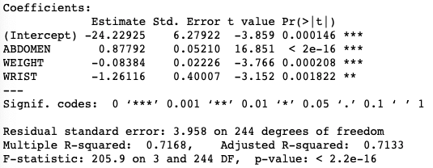
Model Diagnosis and Summary
We choose ABDOMEN, WEIGHT and WRIST as our predictors.
The final model is:
BODYFAT=
0.88 ABDOMEN-0.08 WEIGHT-1.26 WRIST -24.23.
The adjusted R squared is 0.7133.
Residual standard error is 3.958.
All variables are significant.
No serious multicollinearity, mean VIF=3.8.

Slide 17
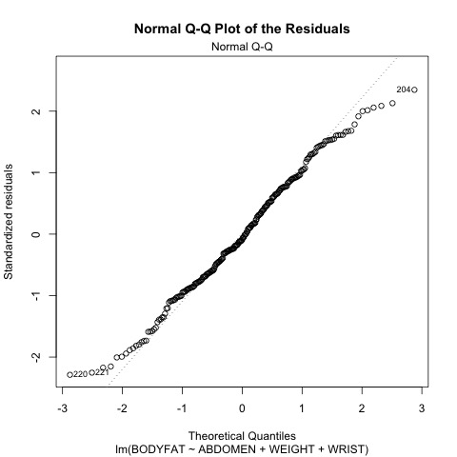
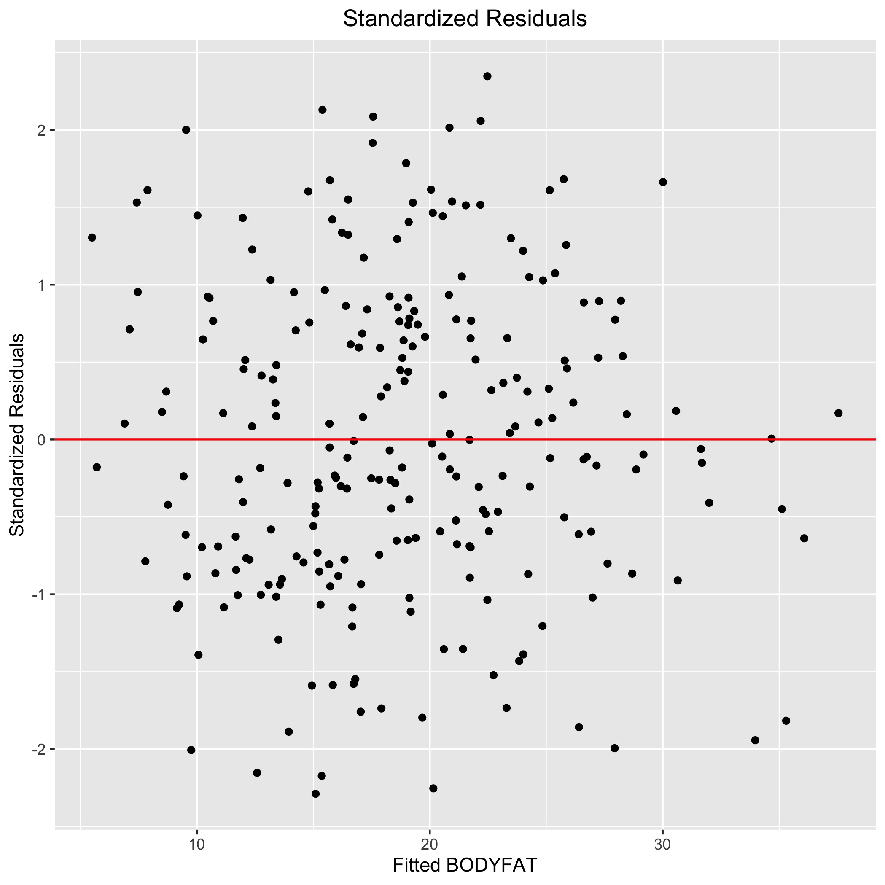
Model Diagnosis – Standardized Residuals, QQ plots for Residuals

Slide 18
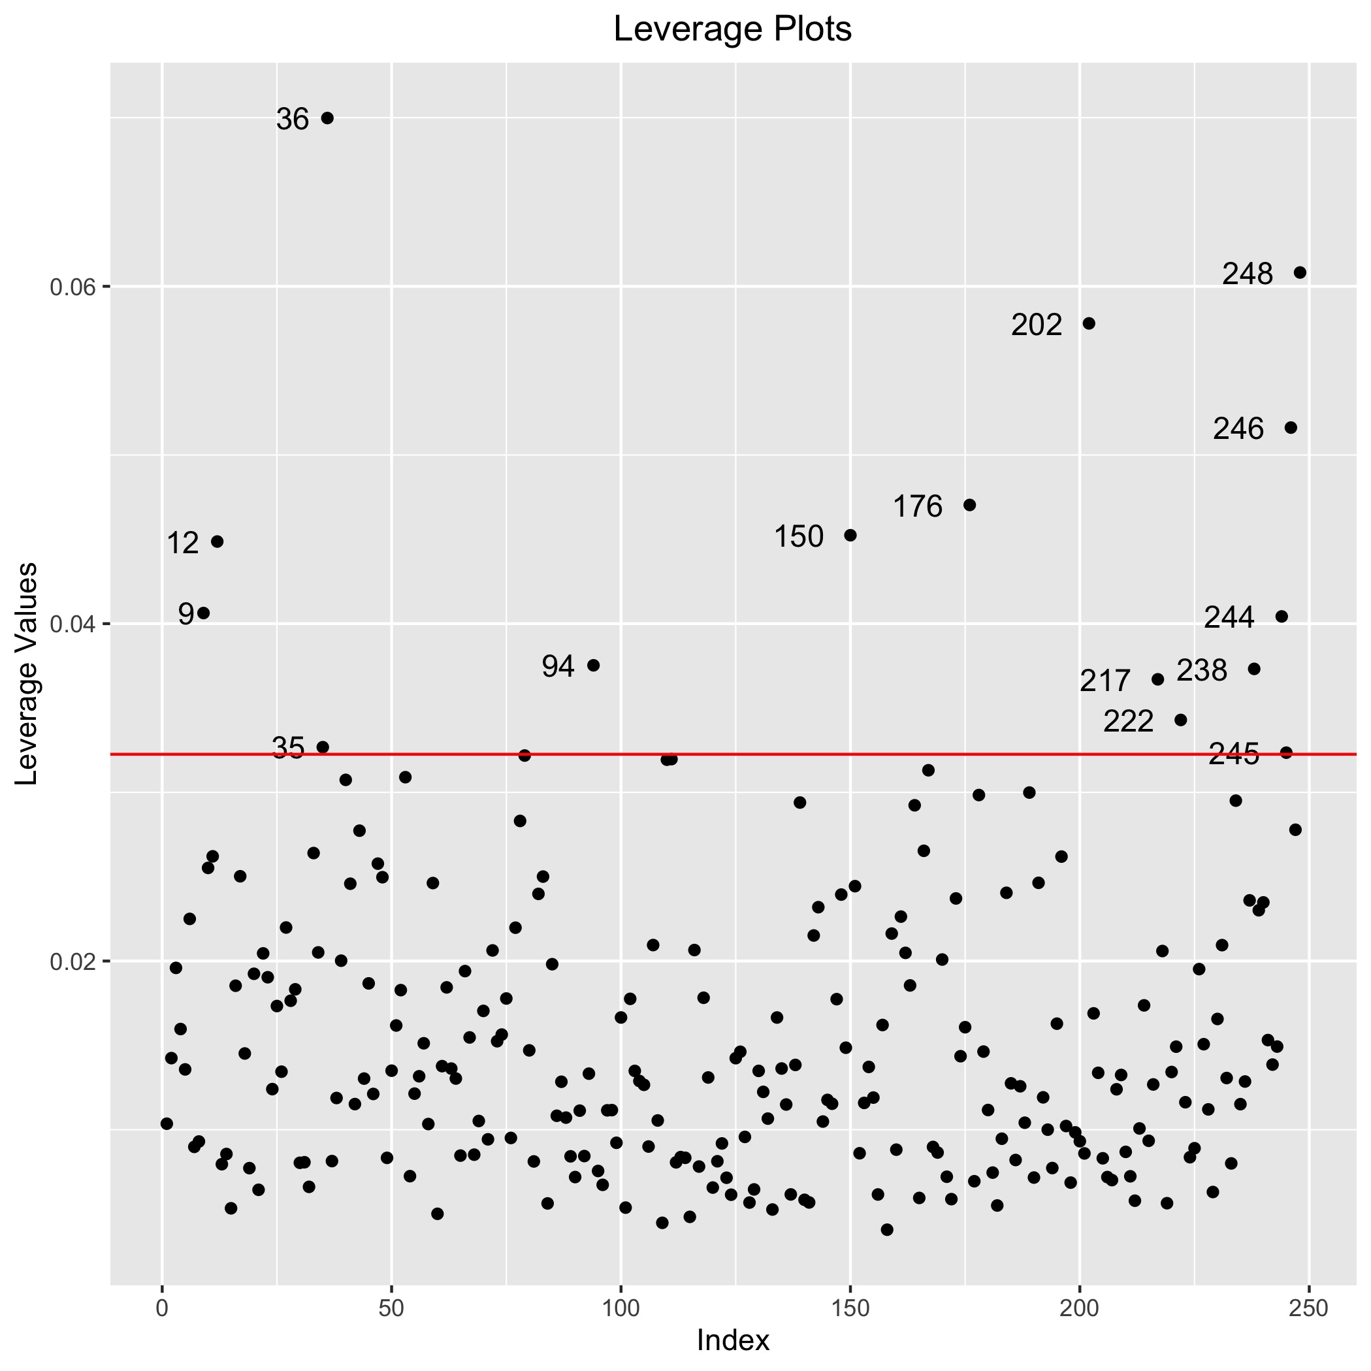
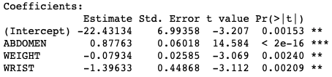
Model Diagnosis – Leverage Plots
The leverage is diagonal elements from 𝐻=𝑋(𝑋′𝑋)⁻¹𝑋′
There is a lot of outliers in Leverage plots.
But the coefficients of model change little after removing the outliers and fitting again.
We keep the initial model .

Slide 19
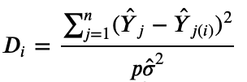
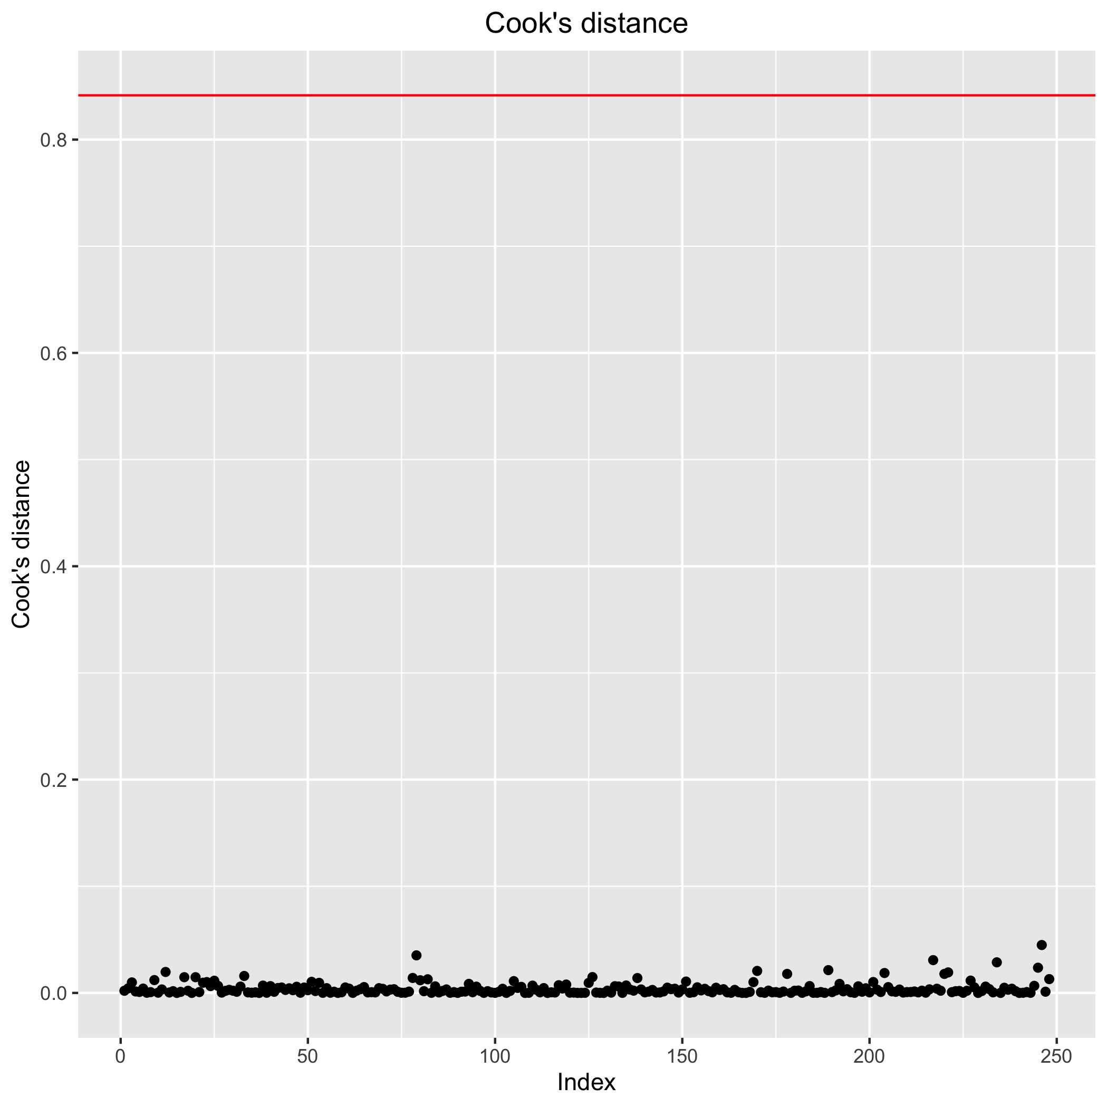
Model Diagnosis – Cook’s Distance
Cook’s distance
measure the influence of i^{th} observation on all n fitted values.
There is no outliers in Cook’s Distance.

Slide 20
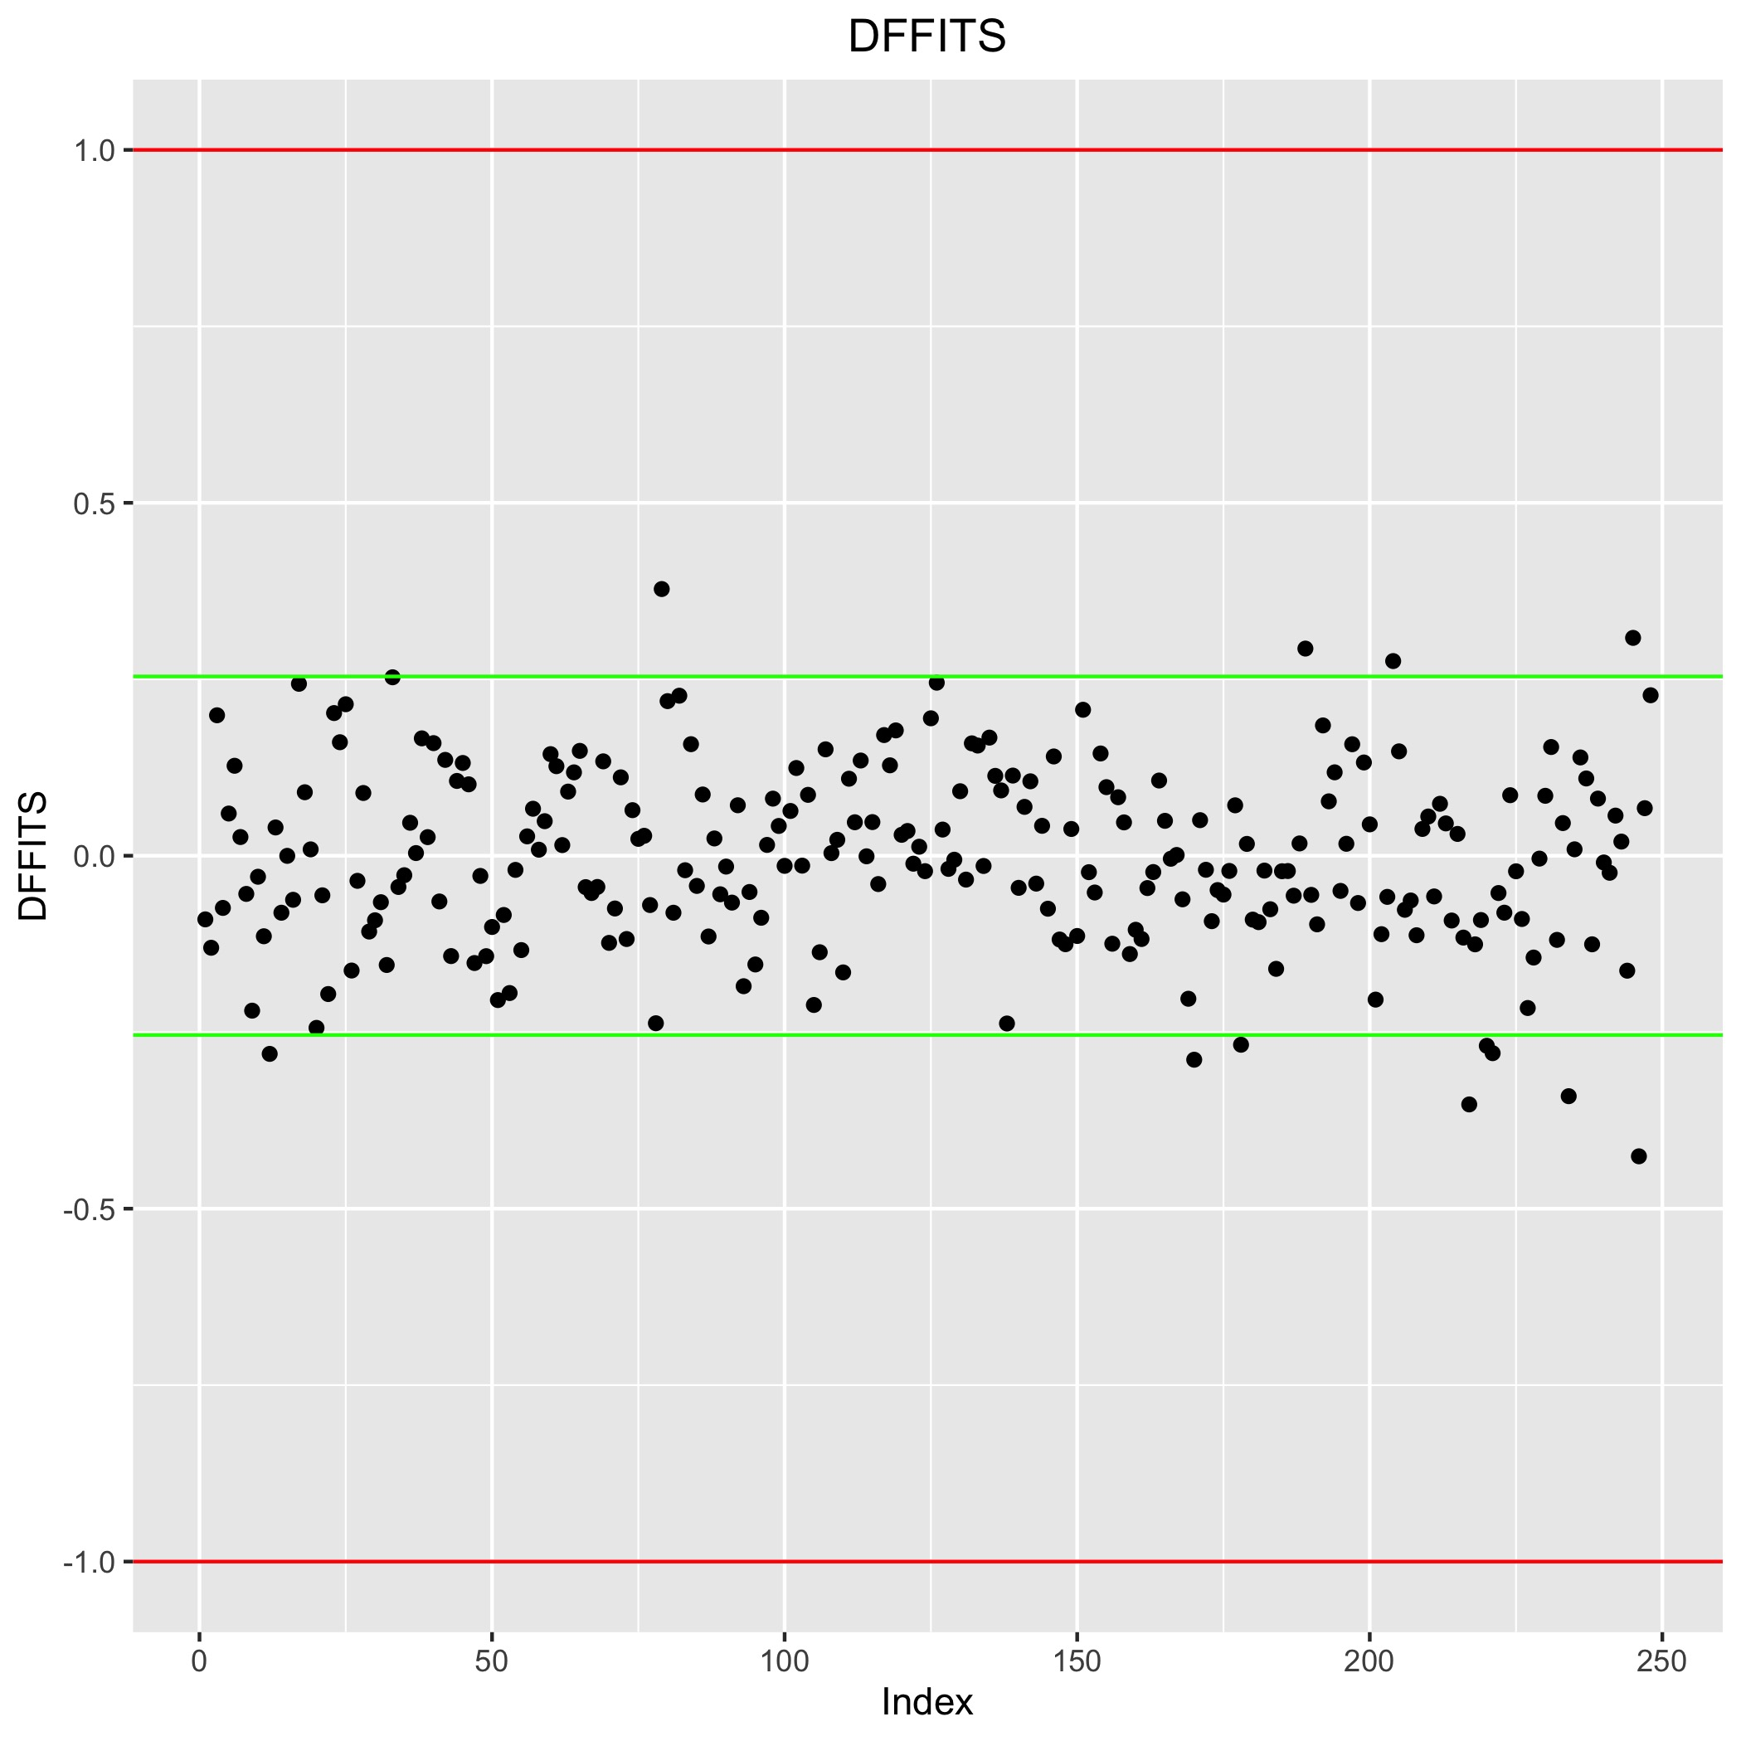
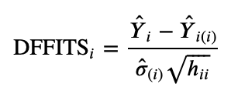
Model Diagnosis - DFFITS
DFFITS
measures the influence of the i^{th} observation on the fitted value yi.
The rule of thumb for small dataset is red lines, for large dataset is green lines.
There is no obvious outliers in DFFITS.

Slide 21
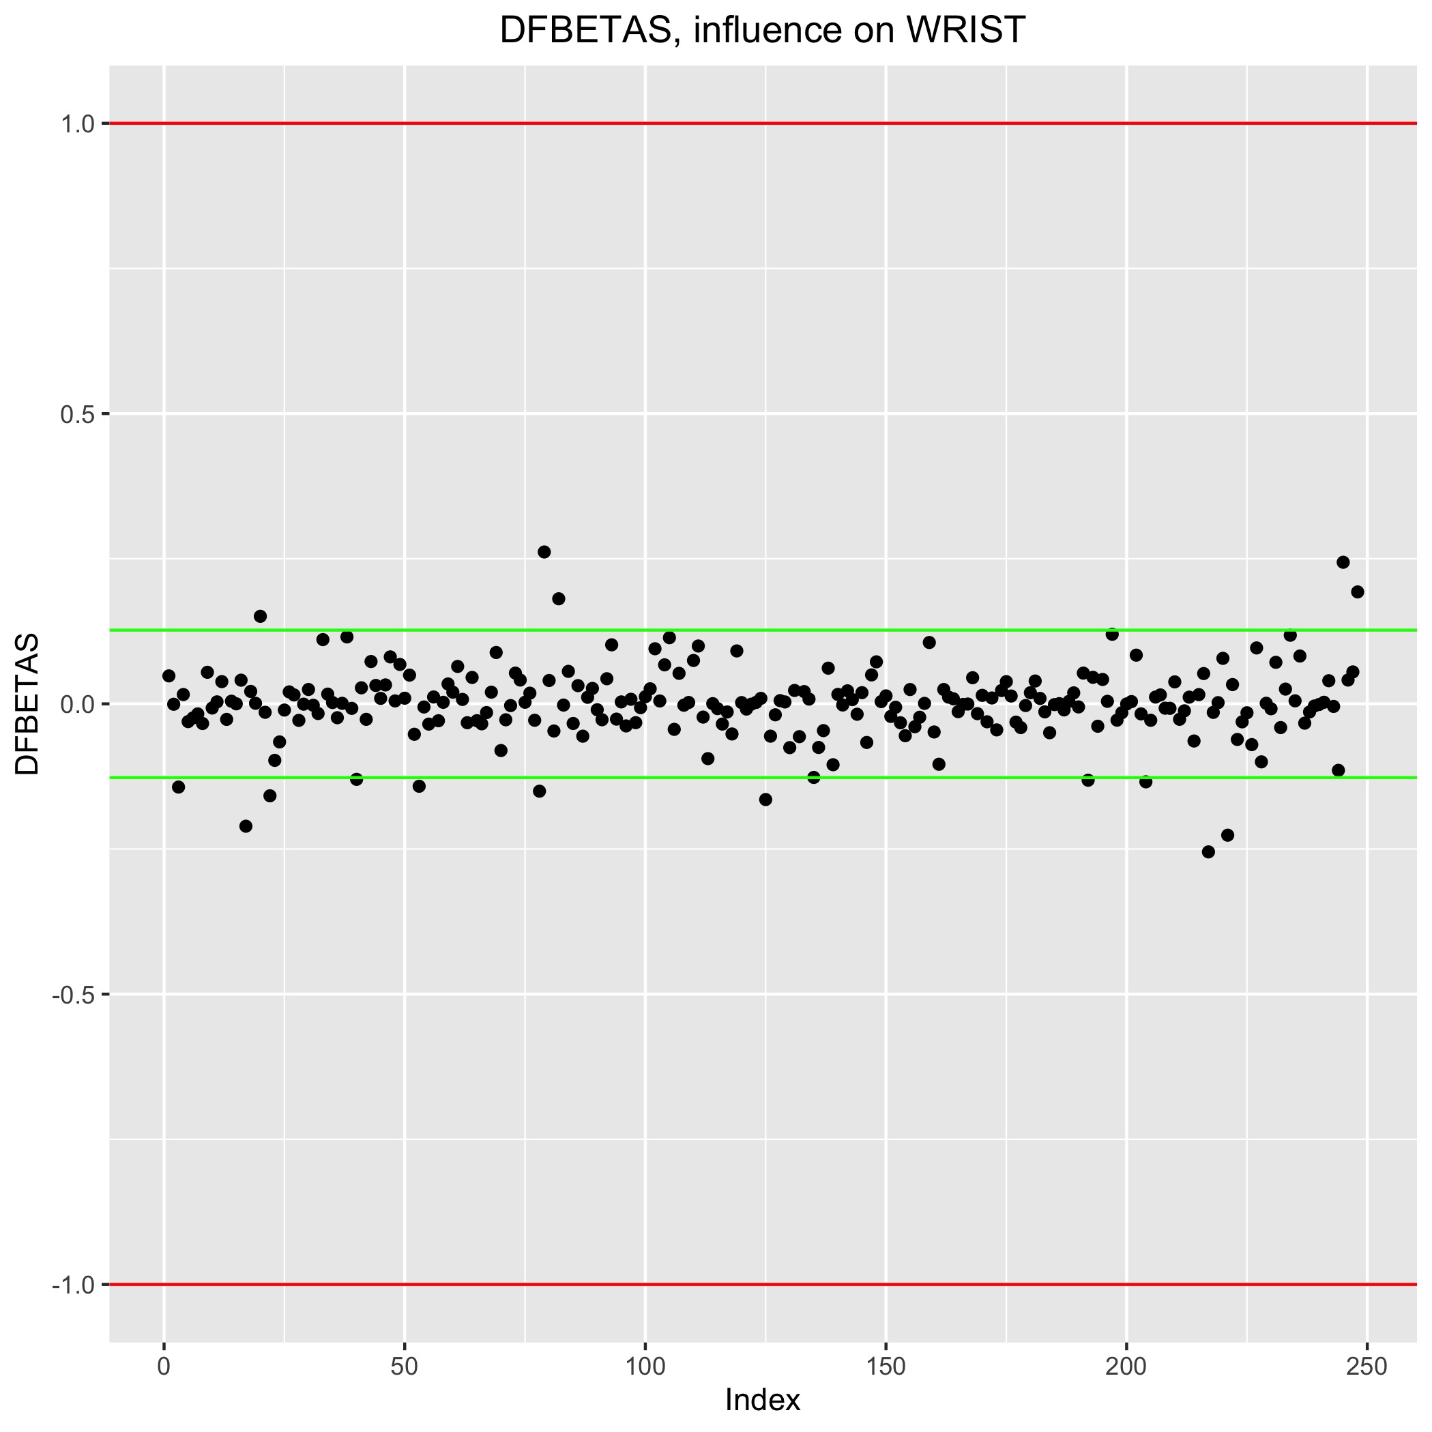
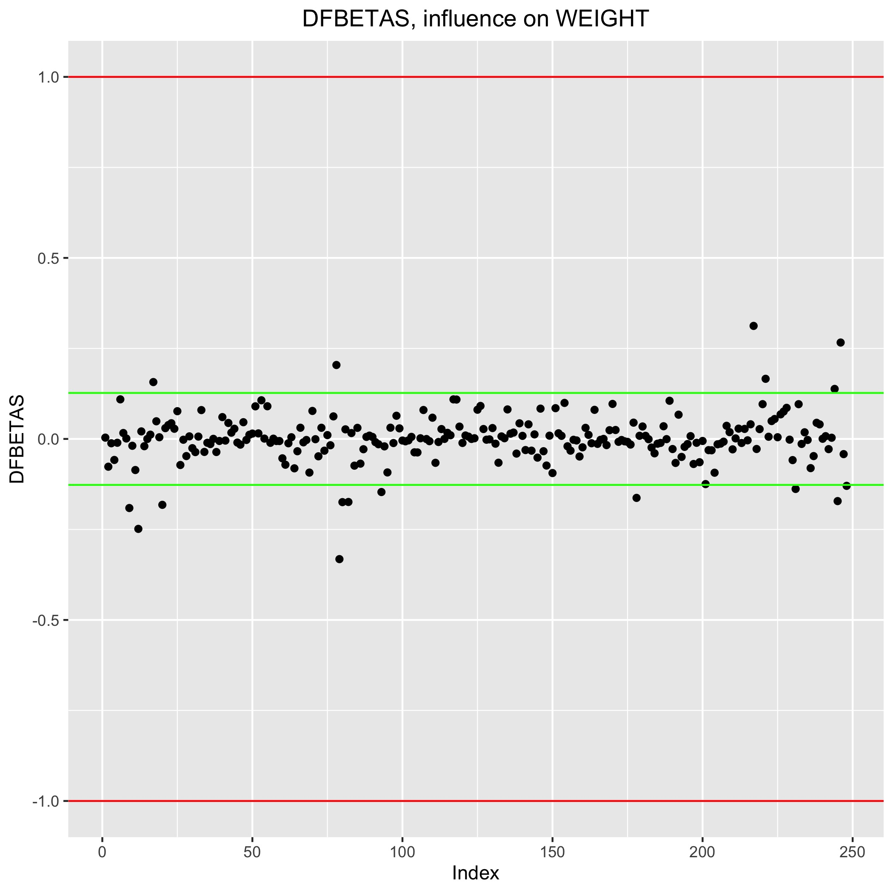
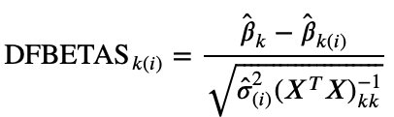
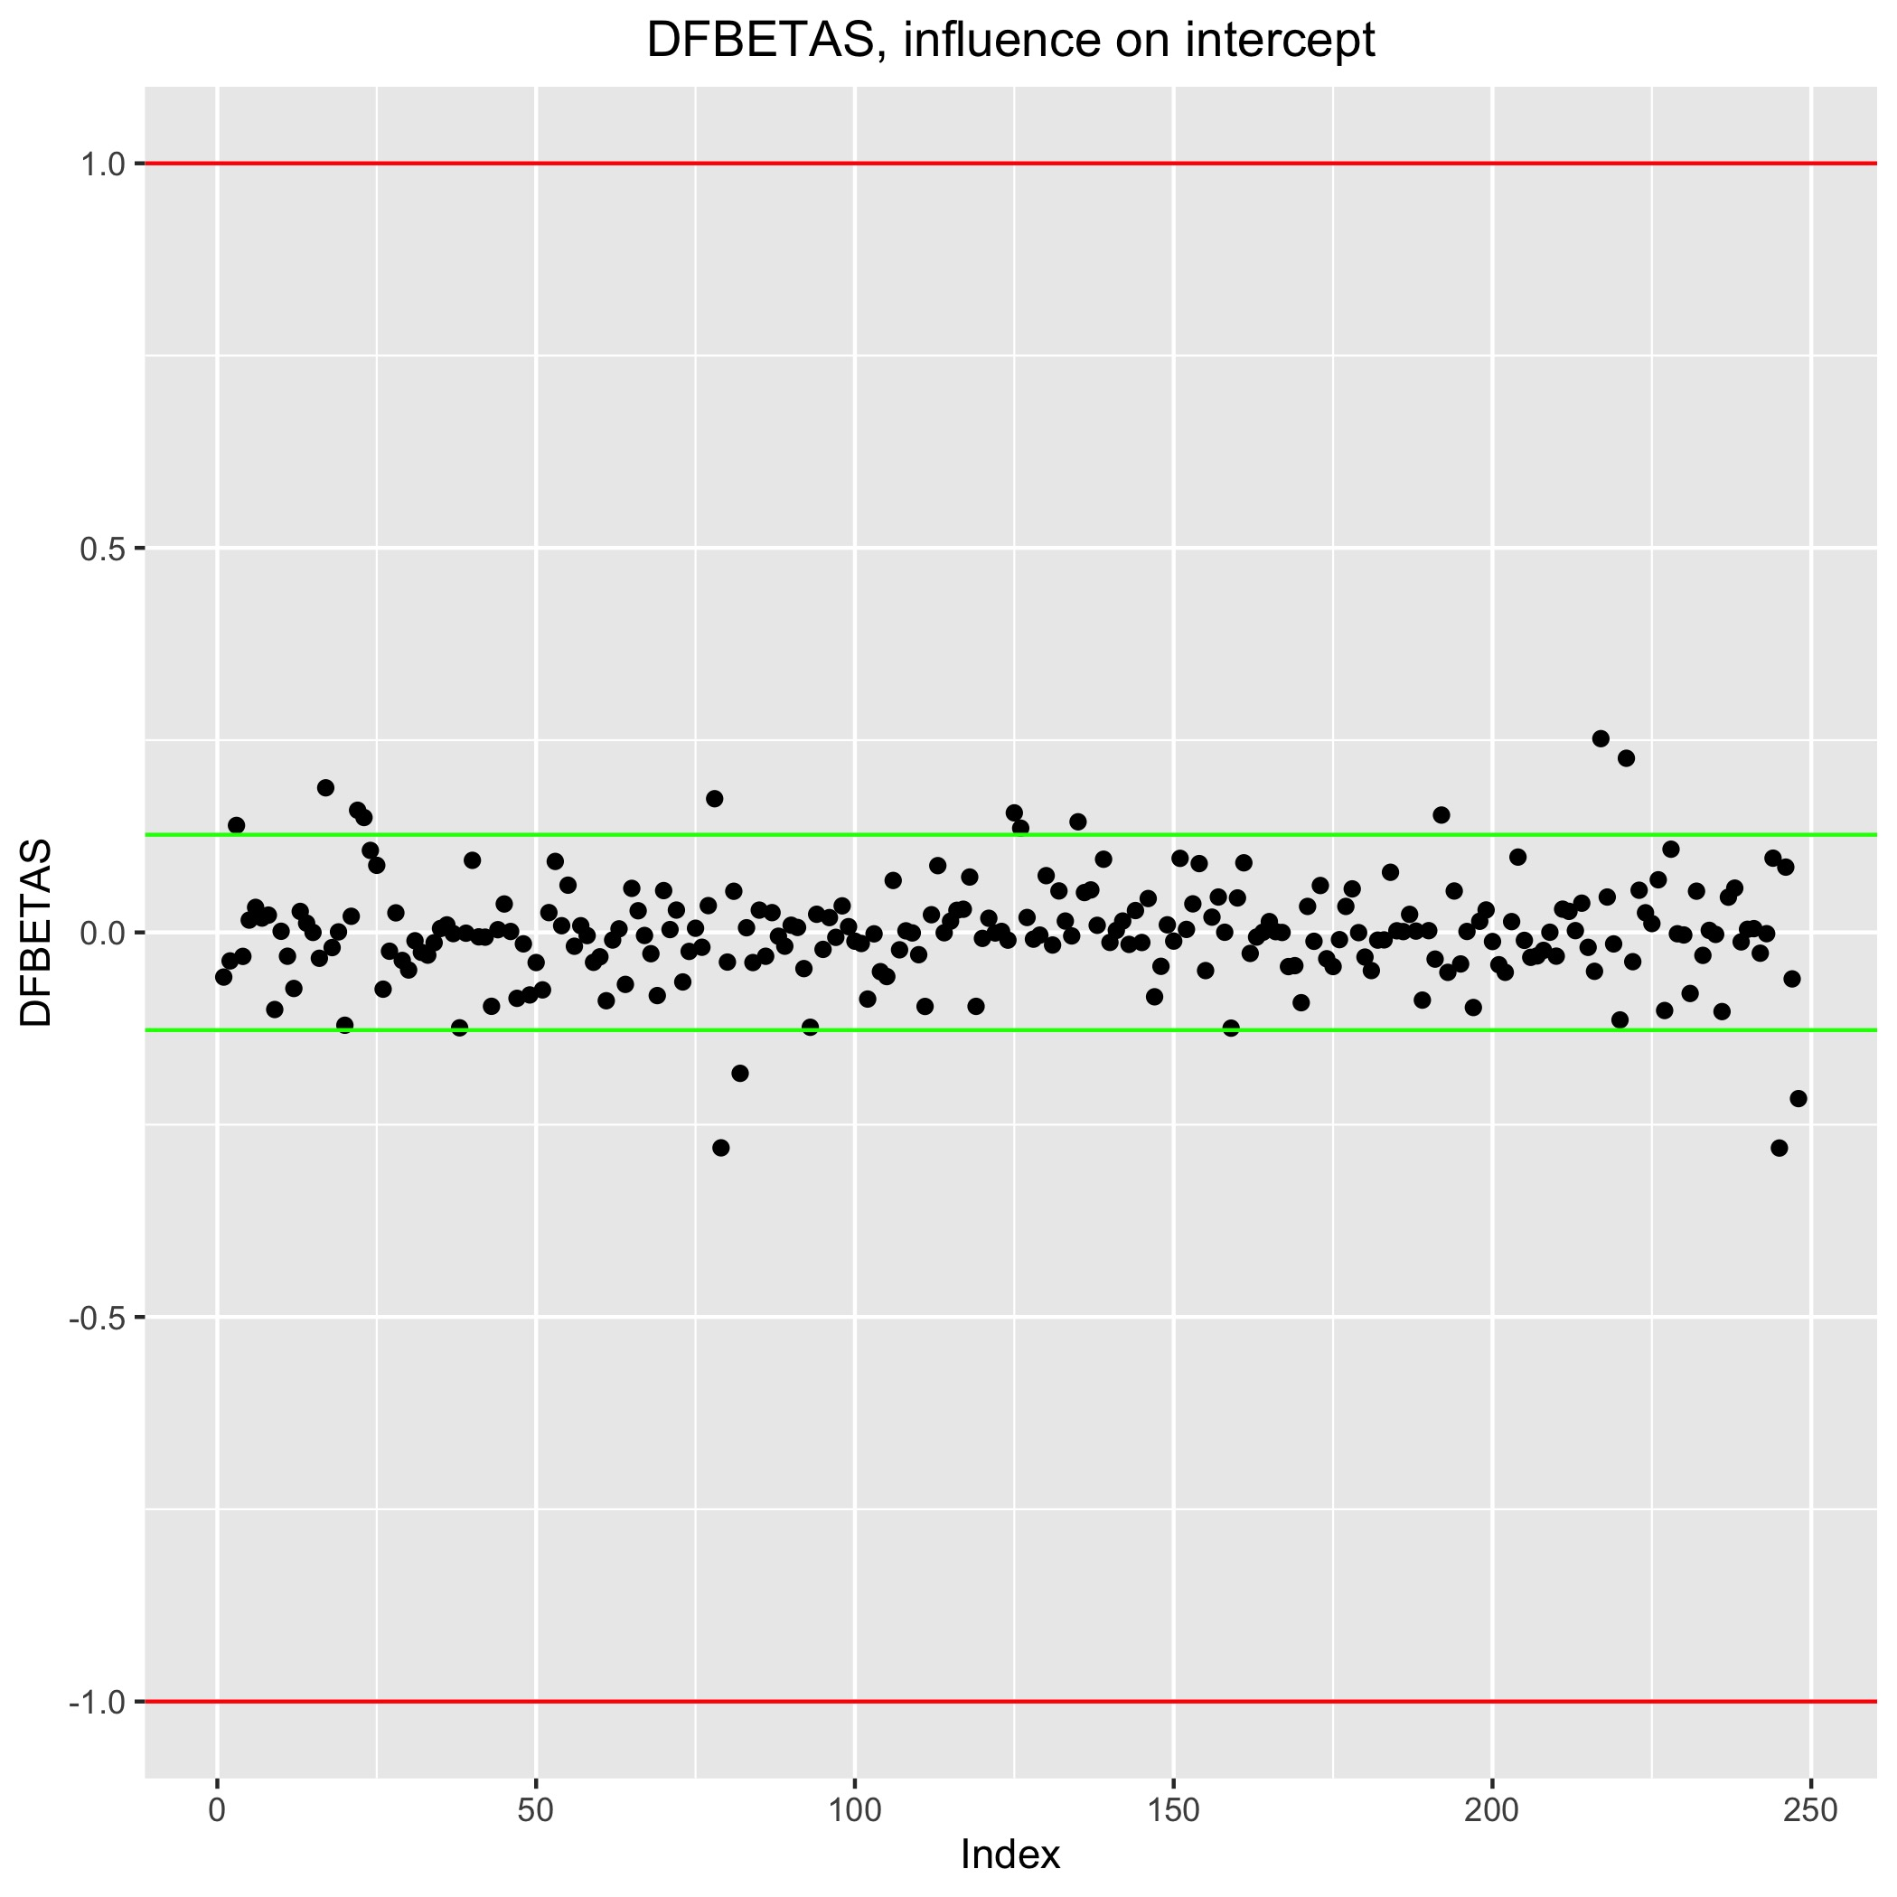
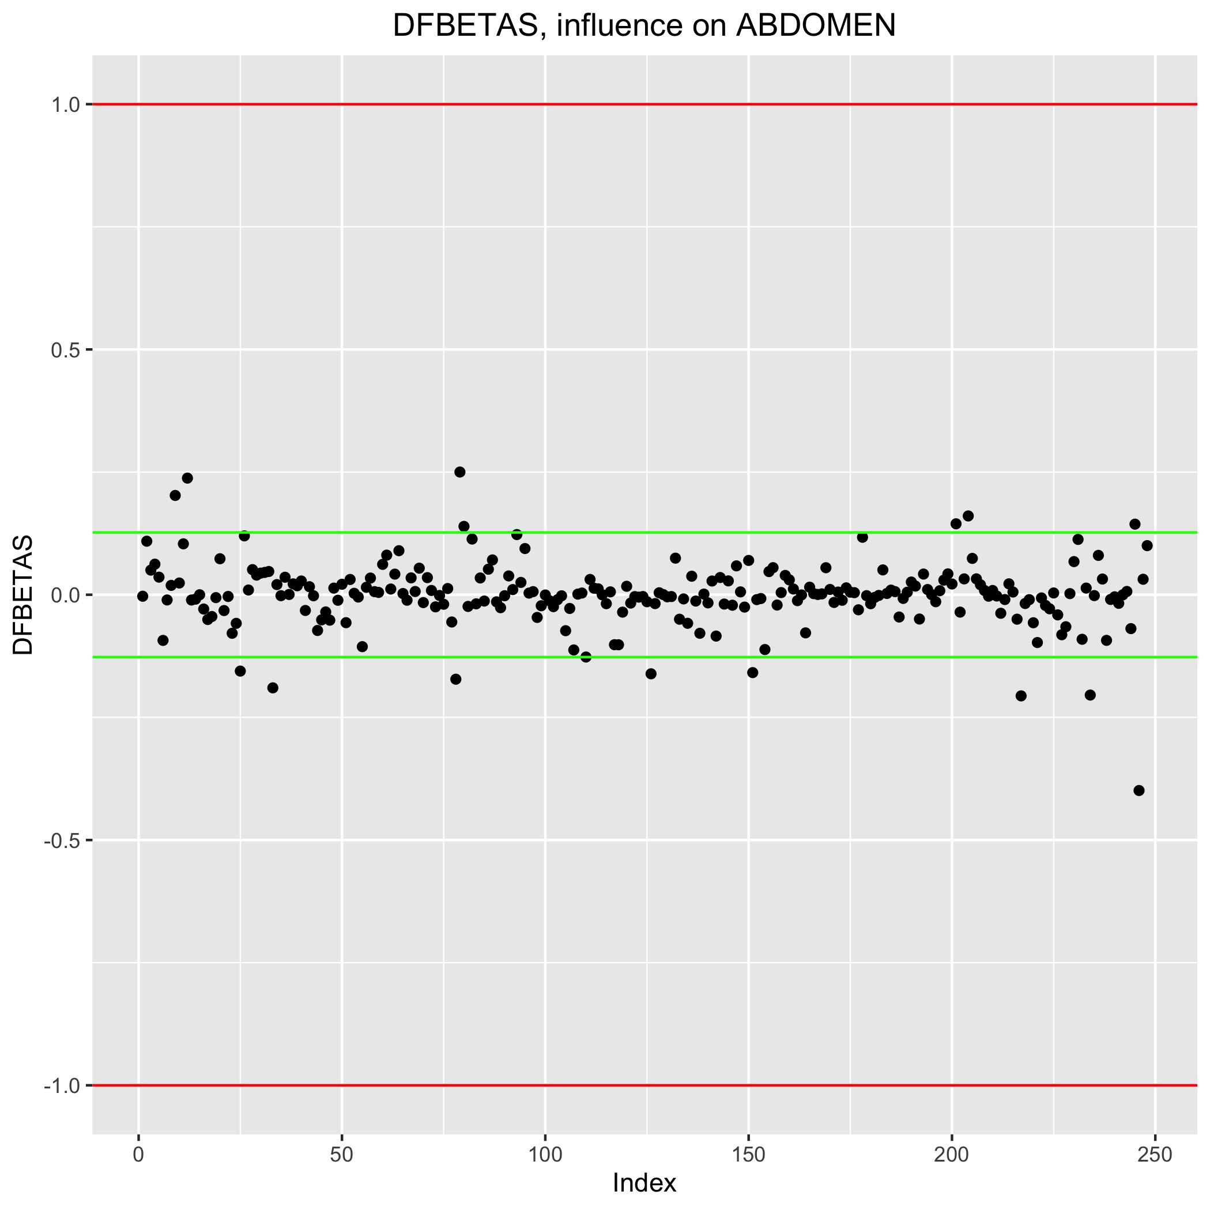
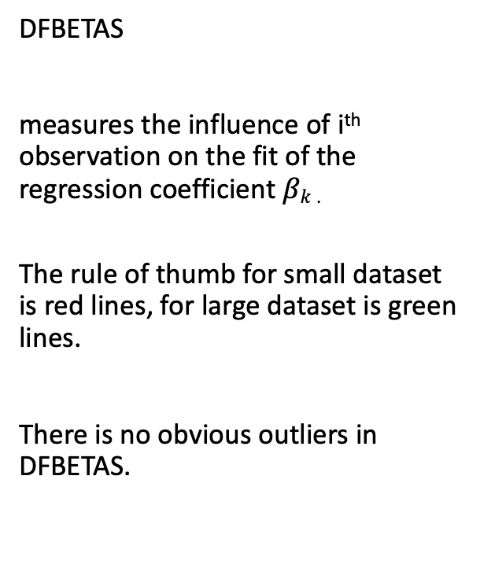
Model Diagnosis - DFBETAS
DFBETAS
measures the influence of i^{th} observation on the fit of the regression coefficient $βk$ .
The rule of thumb for small dataset is red lines, for large dataset is green lines.
There is no obvious outliers in DFBETAS.

Slide 22
Model Diagnosis and Summary
BODYFAT = 0.88 ABDOMEN-0.08 WEIGHT-1.26 WRIST -24.23.
Man with 154 lbs WEIGHT, 17 cm WRIST and 85 cm ABDOMEN, his BODYFAT will be 16(%).
Advantages: Perform well in diagnosis, no serious multicollinearity, linear regression assumptions hold.
Disadvantages: Contains three inputs and some of them are still not convenient to measure. Our model is based on data with only men.
The larger the ABDOMEN is, the larger BODYFAT will be.
The larger the WEIGHT is, the smaller BODYFAT will be.
The larger the ABDOMEN is, the smaller BODYFAT will be.

Slide 23
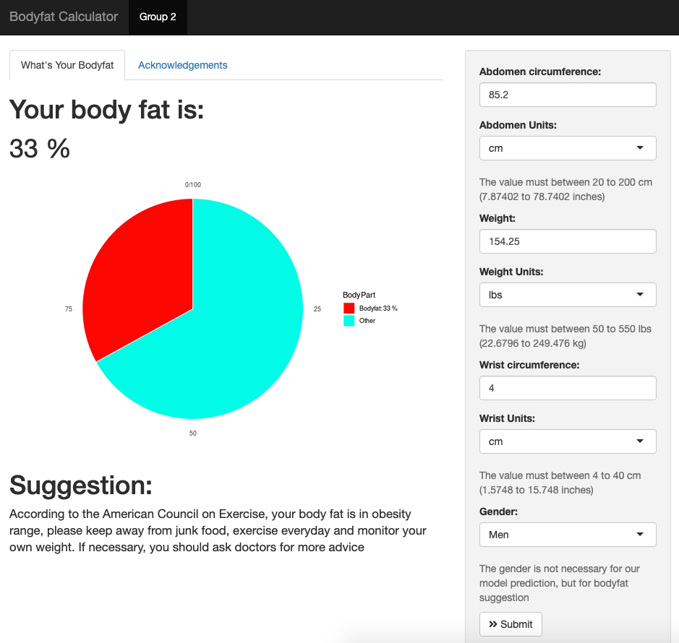
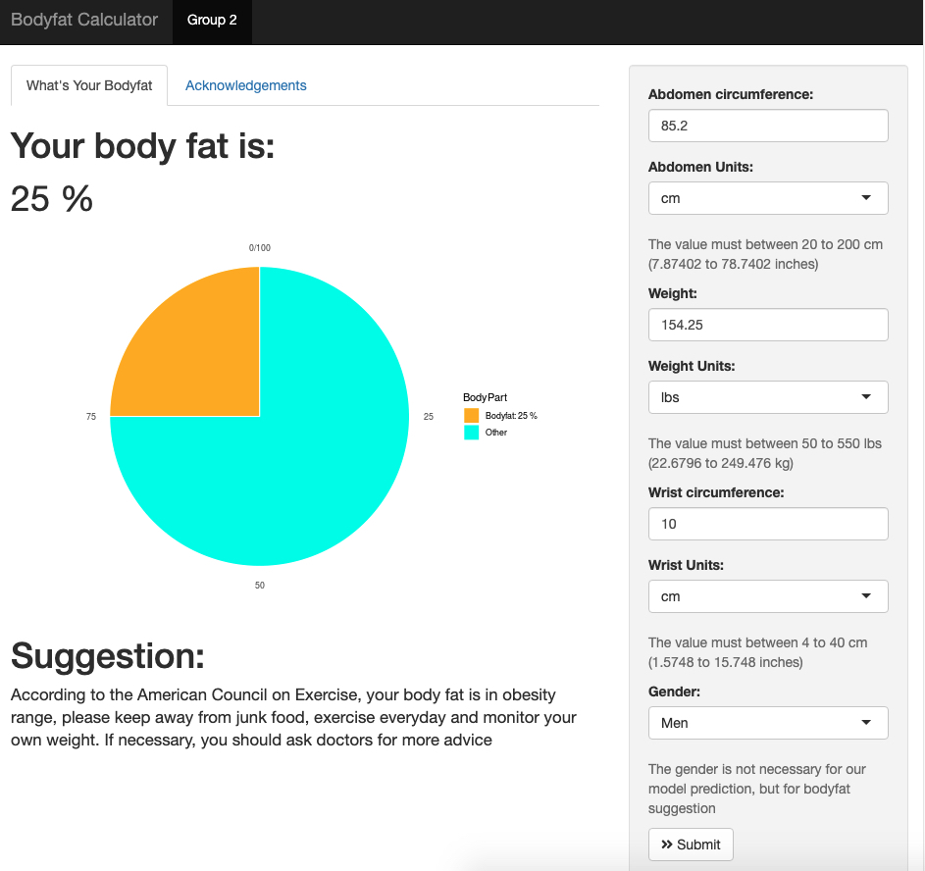
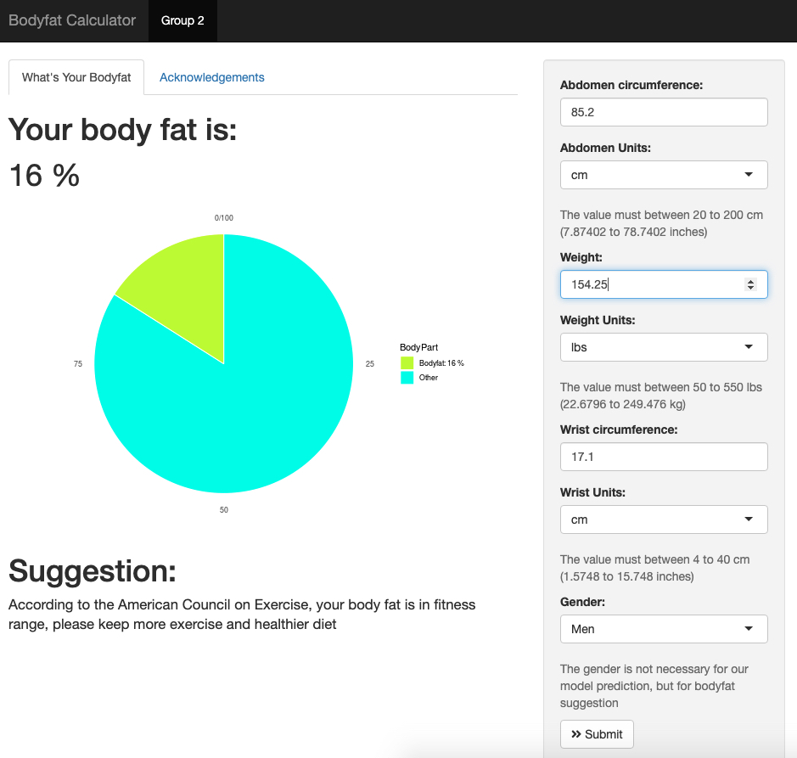
Shiny Application
Unit Change
Color Warning
Body fat suggestion from American Council on Exercise

Slide 24
Acknowledge
GitHub, Main Code
Main code edited by CHENYANG JIANG and ENZE WANG
PCA edited by HanGyu KANG
Model selection fixed by RUI HUANG
GitHub maintained by ENZE WANG
Shiny App
Main edited by RUI HUANG and HanGyu KANG
The interface, ggplot and unit part are fixed, edited and maintained by ENZE WANG
Other problems are fixed by CHENYANG JIANG
Presentation
PPT edited by ENZE WANG
Video edited by HanGyu KANG
Presented with CHENYANG JIANG and RUI HUANG
PDF Summary
Main edited by ENZE WANG
Fixed by RUI HUANG, CHENYANG JIANG and HanGyu KANG

